Slide 1
Chapter 2 NUMBER SYSTEMS, OPERATIONS, AND CODES
数制系统，运算和编码

Slide 2


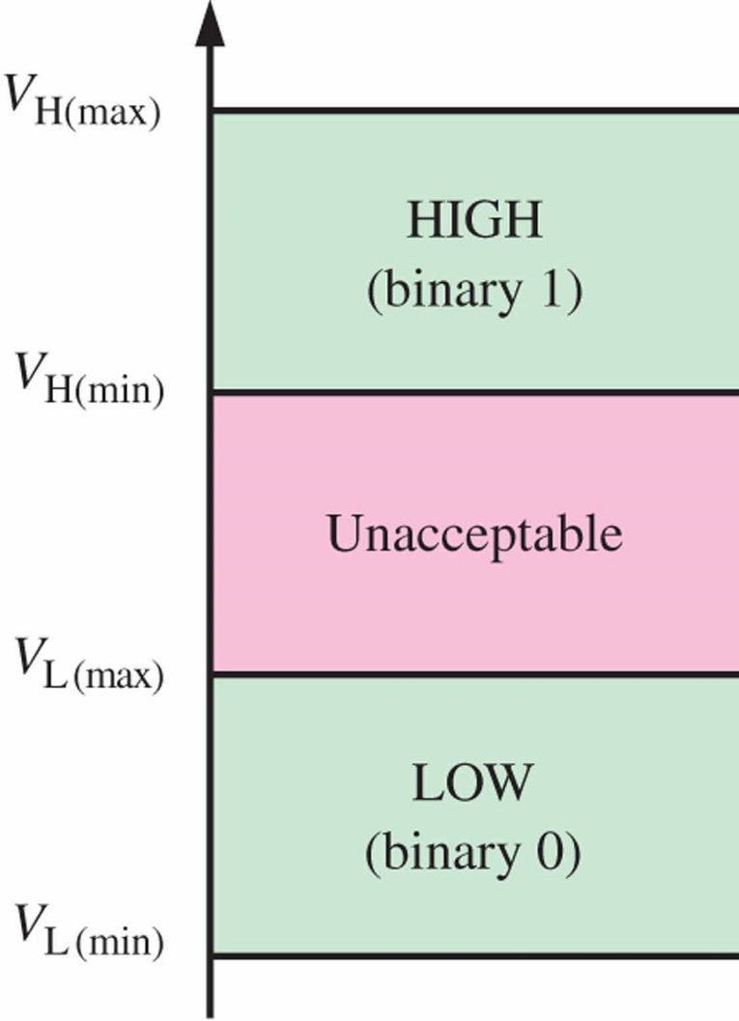
Decimal numbers
六十四
六十四分之一
1个一百
1个一
1个百分之一
11111.111
1个十
1个十分之一
八
八

Slide 3
Numeral systems (NUMber systems) (数制系统)
A numeral system (or system of numeration) is a writing system for expressing numbers; that is, a mathematical notation for representing numbers of a given set, using digits or other symbols in a consistent manner. (https://en.wikipedia.org/wiki/Numeral_system).
Commonly used：Decimal, Binary, Octal, Hexadecimal
e.g. ‘11’ can be interpreted as the binary symbol for three, or the decimal symbol for eleven.

Slide 4
Numeral systems (NUMber systems)
Base (Radix, 基): the number of symbols or digits, including zero, used to represent numbers .
A number is conventionally written as (x)_{y} with x as the string of digits and y as its base
Base 10 number system has ten symbols. 0 … 9
Base 7 number system has seven symbols. 0 ... 6
Base r number system has r symbols. 0 … r-1

Slide 5
Numeral systems (NUMber systems)
Weight(权): More generally, in a system with radix b (b > 1), a string of digits d₁ … d_{n}.f₁f₂…f_{m} denotes the number d₁b^{n−1} + d₂b^{n−2} + … + d_{n}b⁰ + f₁b⁻¹ + … + f_{m}b^{-m}, where 0 ≤ d_{i} < b, 0 ≤ f_{i} < b.
The numbers b^{k} and b^{−k} are the weights of the corresponding digits.

Slide 6
Decimal numbers （十进制数）
Symbols: 0.. 9
Base: 10
536.159₁₀=(5×10²)+(3×10¹)+(6×10⁰) +(1×10⁻¹)+(5×10⁻²)+(9×10⁻³)
Base
Weight

Slide 7
Decimal numbers
In general, a decimal number with the decimal point is written as:
A_{n-1} A_{n-2} … A₁ A₀ . A₋₁ A₋₂ … A_{-(m-1)} A_{-m}
…10⁵ 10⁴ 10³ 10² 10¹ 10⁰. 10⁻¹ 10⁻² 10⁻³ 10⁻⁴ …
Decimal numbers can be expressed as the sum of the products of each digit times its weight.
A_{i} is a digit from 0 to 9, and i denotes the weight (10^{i}) of A_{i}.
A_{n-1} ×10^{n-1} + A_{n-2} × 10^{n-2} +… + A₁×10 + A₀ +
A₋₁ × 10⁻¹ + A₋₂ × 10⁻² +… + A_{-m} × 10^{-m}

Slide 8
Binary numbers (二进制数)
Base: 2.
Symbols: 0, 1
Weights: …2⁵ 2⁴ 2³ 2² 2¹ 2⁰. 2⁻¹ 2⁻² 2⁻³ 2⁻⁴ …
(101101.10)₂
= 1×2⁵ + 0×2⁴ + 1×2³ + 1×2² + 0×2¹ + 1×2⁰
+ 1×2⁻¹ + 0×2⁻²
= 32 + 0 + 8 + 4 + 0 + 1 + ½ + 0
= (45.5)₁₀

Slide 9
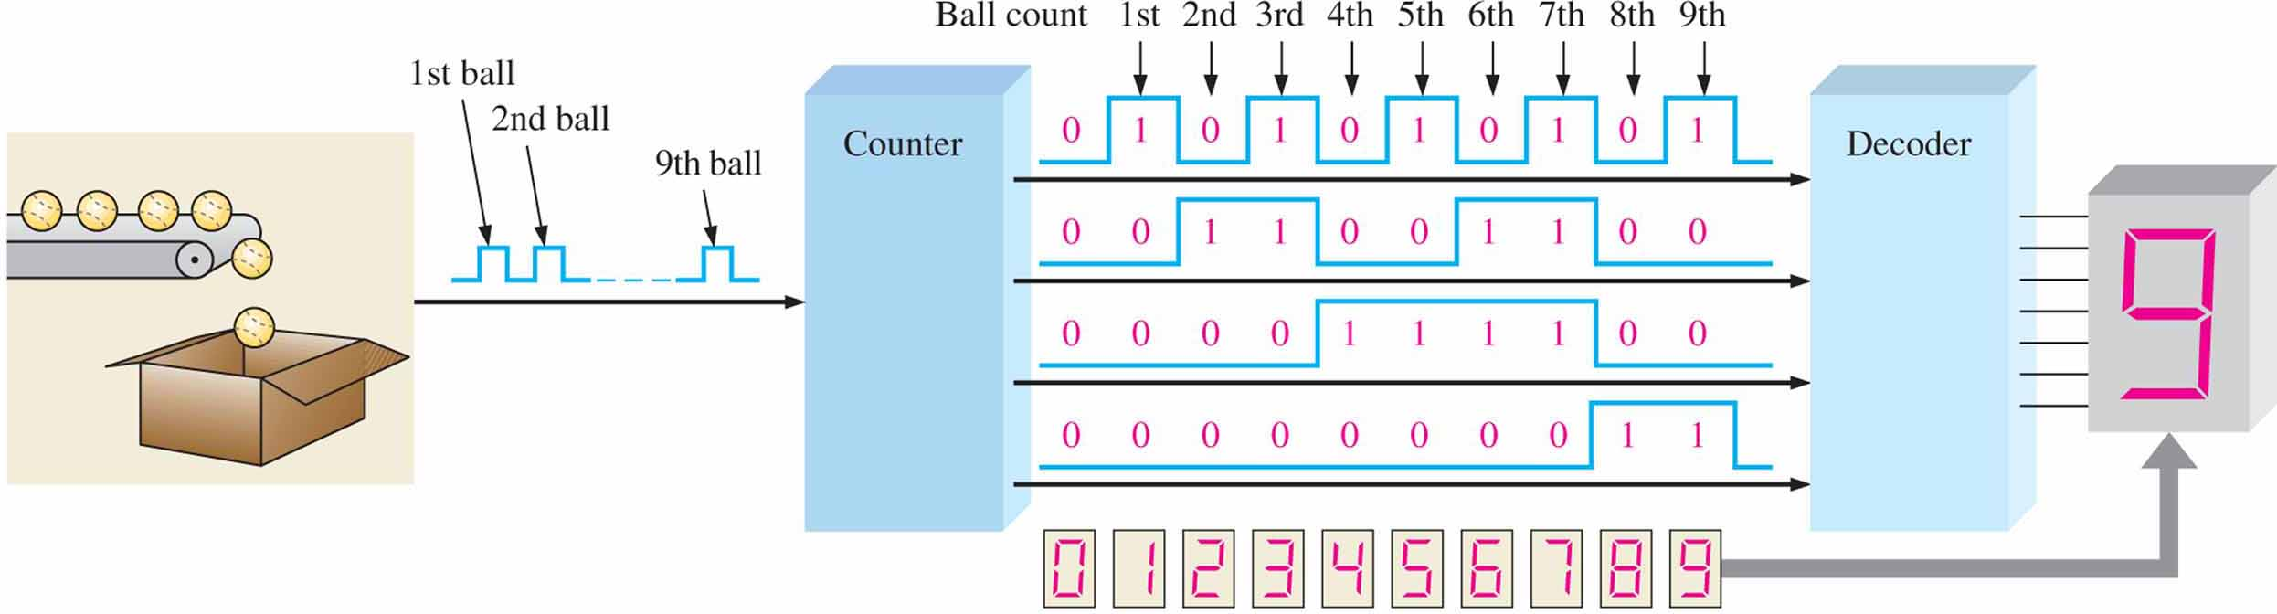
Binary numbers
Decimal Number
Binary Number
0 0 0 0 0
1 0 0 0 1
2 0 0 1 0
3 0 0 1 1
4 0 1 0 0
5 0 1 0 1
6 0 1 1 0
7 0 1 1 1
8 1 0 0 0
9 1 0 0 1
10 1 0 1 0
11 1 0 1 1
12 1 1 0 0
13 1 1 0 1
14 1 1 1 0
15 1 1 1 1
A binary counting sequence for numbers from zero to fifteen is shown.
Notice the pattern of zeros and ones in each column

Slide 10
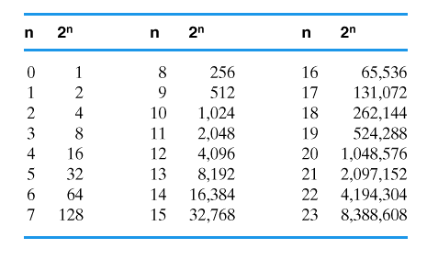
Binary numbers
In general, with n bits you can count up to a number equal to 2^{n}-1.

Slide 11
Octal Numbers(八进制数)
Base: 8
Symbols: 0..7
(231.25)₈=2×8² + 3×8¹+1×8⁰+2×8⁻¹+5×8⁻²
=(153.328125)₁₀

Slide 12
Hexadecimal numbers (十六进制数)
Base: 16
Symbols: 0..9, A, B, C, D, E, F
A=10 B=11 C=12 D=13 E=14 F=15

Slide 13
Hexadecimal numbers
Example 1.
Example 2.
(3FB)₁₆ = 3×16² + 15×16¹ + 11×16⁰
= 768 + 240 + 11
= (1019)₁₀
(A59C.3A)₁₆ = A×16³ + 5×16² + 9×16¹ + C×16⁰ + 3×16⁻¹ + A×16⁻²
=40960 + 1280 + 144 + 12 + 3/16 + 10/256
=(42396.2265625)₁₀

Slide 14
Arbitrary base? (任意进制)
Base: r
Symbols: 0.. r-1
N = A_{n-1} ×r ^{n-1} + A_{n-2} × r ^{n-2} +… + A₁ × r + A₀ +
A₋₁ × r ⁻¹ + A₋₂ × r ⁻² +… + A_{-m} × r ^{-m}
MSB：Most Significant Bit
LSB：Least Significant Bit

Slide 15
Number System Conversion (数制转换)
Decimal | Binary | Octal | Hexadecimal
0 | 0000 | 00 | 0
1 | 0001 | 01 | 1
2 | 0010 | 02 | 2
3 | 0011 | 03 | 3
4 | 0100 | 04 | 4
5 | 0101 | 05 | 5
6 | 0110 | 06 | 6
7 | 0111 | 07 | 7
8 | 1000 | 10 | 8
9 | 1001 | 11 | 9
10 | 1010 | 12 | A
11 | 1011 | 13 | B
12 | 1100 | 14 | C
13 | 1101 | 15 | D
14 | 1110 | 16 | E
15 | 1111 | 17 | F

Slide 16
Binary←→Octal(2³=8)
( 011|010|101|000|.|111|101|011|100 )₂
( 3 2 5 0 . 7 5 3 4 )₈
Exercise: Convert the following binary numbers to octal
(010011110111.11010101)₂
Answer: 2367.652₈

Slide 17
Binary←→Hexadecimal(2⁴=16)
( 0110|1010|1000|.|1111|0101|1100 )₂
( 6 A 8 . F 5 C )₁₆
Exercise: Convert the following binary numbers to hexadecimal
(010011110111.11010101)₂
Answer: 4F7.D50₁₆

Slide 18
Hexadecimal ←→Octal
Hexadecimal
Binary
Octal
Exercise: Convert the octal numbers 367.236₈ to hexadecimal.
Answer: F7.4F₁₆
367.236₈=011,110,111.010,011,110₂
0,1111,0111.0100,1111,0₂=F7.4F₁₆

Slide 19
Binary → Decimal
11001.011₂
=1×2⁴ + 1×2³ + 0×2² + 0×2¹ + 1×2⁰ + 0× 2⁻¹ + 1×2⁻² + 1×2⁻³
=16 + 8 + 0 + 0 + 1 + 0 + 1/4 + 1/8
=25.375₁₀

Slide 20
Decimal → Binary
Convert the integer part and fractions part separately, then merge the result.
Integer part : divide it by 2 and take the remainder.
Fractions part: double it and get the integer part.

Slide 21
Decimal → Binary (Integer part)
The number is divided by 2. The remainder is the least-significant bit. The quotient(商) is again divided by two; its remainder(余数) becomes the next least significant bit. This process repeats until a quotient of 0 is reached. The sequence of remainders forms the binary value.

Slide 22
Decimal → Binary(Integer part)
Example：Convert 119₁₀ to binary
Answer：119₁₀=1110111₂
（LSB）
（MSB）

Slide 23
Decimal → Binary(Fractions)
?
In a fractional binary number such as 0.1101, the first digit is 1/2, the second (1/2)² = 1/4, etc. So if there is a 1 in the first place after the decimal, then the number is at least 1/2, and vice versa. Double that number is at least 1.

Slide 24
Decimal → Binary(Fractions)
This suggests the algorithm: Repeatedly double the number to be converted, record if the result is at least 1, and then throw away the integer part.

Slide 25
Decimal → Binary(Fractions)
Example: Convert the number 0.75₁₀ to binary.
Answer: .75₁₀ = .110₂ = 1× 2⁻¹ + 1×2⁻²
.75 × 2 = 1.5………1（MSB）
.5 × 2 = 1.0………..1
.0 × 2 = 0.0………..0（LSB）

Slide 26
Decimal → Binary
Example: Convert the number 25.638₁₀ to binary.
Answer: 25.638₁₀=11001.1010₂
This method can be extended to any number systems with base r:
Integer part : divide it by r and take the remainder
Fractions part: multiply it by r and get the integer part

Slide 27
Arbitrary base ←→ Decimal
Exercise : Convert the number 324.2₅ to decimal.
Answer:
Exercise:
1. Convert the number 345.2₆ to decimal.
2. Convert the number 34.8₁₀ to quinary(五进制)
(324.2)₅ = 3×5² + 2×5¹ + 4×5⁰ + 2×5⁻¹
=75 + 10 + 4 + 2/5
=(89.4)₁₀

Slide 28
Binary arithmetic 二进制算术
Addition
0+0=0；0+1=1；1+0=1；
1+1=(1)0（carry 1）
Subtraction
0-0=0；1-0=1；1-1=0；
(1)0-1=1（borrow 1）
Multiplication
0×0=0；1×0=0；0×1=0；
1×1=1
Division: The divisor cannot be 0.
0÷1=0；1÷1=1

Slide 29
Binary arithmetic
Example: Let A=11110₂，B=110₂, calculate: A＋B； A－B；

Slide 30
Binary arithmetic
Example: Let A=11110₂，B=110₂, calculate: A×B； A÷B

Slide 31
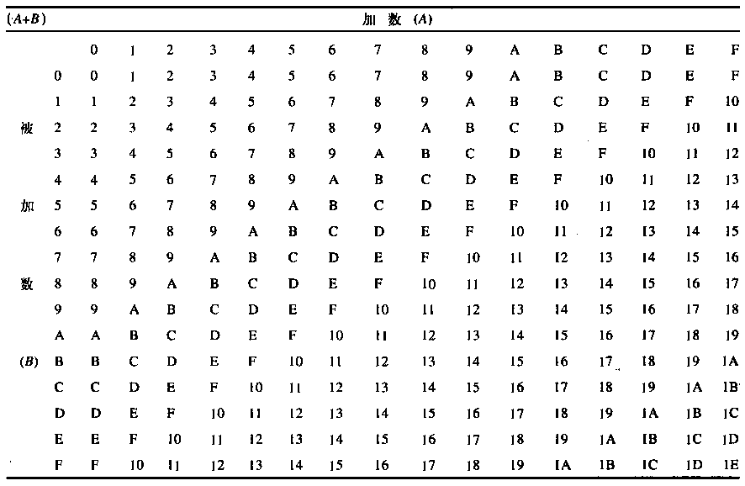
Hex arithmetic- addition

Slide 32
Binary code (二进制编码)
A binary code represents text, computer processor instructions, or other data using any two-symbol system, but often the binary number system‘s 0 and 1.
Some codes are suitable for arithmetic operations; some are good at the delivery of information to the system's digital sensors. Binary code can also be used to represent signed numbers.

Slide 33
Complements of binary numbers (二进制数的反码和补码)
1’s complement(以1为基的补码 — 反码)
2’s complement(以2为基的补码 — 补码)

Slide 34
1’s complement (反码)
The 1’s complement of a binary number is just the inverse of the digits. To form the 1’s complement, change all 0’s to 1’s and all 1’s to 0’s.
[N]₂₋₁ = 2^{n} - (N)₂ - 1 (n is the number of digits in (N)₂)
In digital circuits, the 1’s complement is formed by using inverters
1 1 0 0 1 0 1 0
0 0 1 1 0 1 0 1

Slide 35
2’s complement (补码)
The 2’s complement of a binary number is found by adding 1 to the LSB of the 1’s complement
[N]₂ = 2^{n} - (N)₂
n is the number of digits in (N)₂.
1 1 0 0 1 0 1 0
Another way to convert it is working from LSB towards MSB
0 0 1 1 0 1 1 0
Flip all the remaining bits.
Find the first 1 and copy the right part

Slide 36
Examples
(N)₂ = (101001)₂ (hint: n=6)
1's complement: [010110]₂₋₁
2's complement: [010111]₂
(N)₂=(1010)₂. If n = 6 ?
1’s complement: [N]₂₋₁ = 2⁶ - (1010)₂ = (110101)₂
2's complement: [N]₂ = (1000000)₂ - (1010)₂ = (110110)₂

Slide 37
Signed numbers （有符号数）
signed magnitude form (原码)
1’s complement form (反码形式)
2’s complement form (补码形式)

Slide 38

Signed magnitude form (原码)
|N|
There are several ways to represent signed binary numbers. In all cases, the MSB in a signed number is the sign bit, that tells you if the number is positive or negative.
0/1 | x | x | x | x | x | x | x
Sign bit
符号位
$$−2^{n}<N<2^{n}$$
Magnitude bit(n)
数值位
0: +
1: -

Slide 39
Signed magnitude form
Example: N = 1101₂
(+N)₂=01101
(-N)₂= 11101
How about 0?
+000…00=0 000…00
- 000…00=1 000…00

Slide 40
Complement form (补码形式)
1’s complement form
Positive: remain the same as signed magnitude codes.
Negative: the 1’s complement of the corresponding positive number.
2’s complement form
Positive: remain the same as signed magnitude codes.
Negative: the 2’s complement of the corresponding positive number.

Slide 41
1’s complement form
Example: N = 1101₂
[+N]₂₋₁=01101
[-N]₂₋₁=10010
How about 0?
+000…00=0 000…00
- 000…00=1 111…11

Slide 42
2’s complement form
Example: N = 1101₂
[+N]₂=01101
[-N]₂= 10011
How about 0?
[±000…00]₂=0 000…00

Slide 43
2’s complement form
N=1010₂, calculate 2‘s complement of –N with 1 sign bit and 7 magnitude bit.
(+N)₂=(00001010)₂
[-N]₂ = [11110110]₂
Attention: (N)₂ + [-N]₂ = 2⁸ (1+7=8).

Slide 44
Arithmetic with 1’s complement form*
How to calculate?
N₁+N₂: [N₁]₂₋₁ + [N₂]₂₋₁ = [N₁+N₂]₂₋₁
N₁ - N₂: [N₁]₂₋₁ + [-N₂]₂₋₁ = [N₁-N₂]₂₋₁
If the carry extends past the end of the word, the bit must be added back in at the right-most bit.

Slide 45
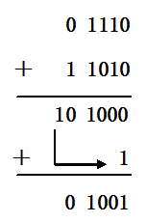
Arithmetic with 1’s complement form*
Example: N₁=+1110，N₂=+0101, use 1’s complement form to calculate N₁-N₂.
[N₁]_{1’s} = 01110
[-N₂]_{1’s} = 11010
[N₁-N₂]_{1’s} = [N₁]_{1’s} + [-N₂]_{1’s} = 01110+11010 = 01001
If the carry extends past the end of the word, the bit must be added back in at the right-most bit.

Slide 46
Arithmetic with 2’s complement form
N₁+N₂：[N₁]₂+[N₂]₂=[N₁+N₂]₂
N₁-N₂：[N₁]₂+[-N₂]₂=[N₁-N₂]₂
Rules for it: Add the two signed numbers. Discard any final carries. The result is in signed form.
00011110 = +30
00001111 = +15
00001110 = +14
11101111 = −17
11111111 = −1
11111000 = −8
00101101
= +45
11111101
= −3
1
11110111
= −9
Discard carry

Slide 47





Arithmetic examples
9+3=12
(-9)+(-3)=-12
9 - 3=6
$$\frac{\begin{matrix} & 0^1001 \\ + & 0^0011\end{matrix}}{\begin{matrix} & 0^1100\end{matrix}}$$
$$\frac{\begin{matrix} & 1^0111 \\ + & 1^1101\end{matrix}}{\begin{matrix} & 1^0100\end{matrix}}$$
$$\frac{\begin{matrix} & 0^1001 \\ + & 1^1101\end{matrix}}{\begin{matrix} & 0^0110\end{matrix}}$$
1
1
9-(-3)=-12
3 - 9=-6
$$\frac{\begin{matrix} & 0^1001 \\ + & 0^0011\end{matrix}}{\begin{matrix} & 0^1100\end{matrix}}$$
$$\frac{\begin{matrix} & 0^0011 \\ + & 1^0111\end{matrix}}{\begin{matrix} & 1^1010\end{matrix}}$$

Slide 48
Arithmetic examples
X=-8₁₀，Y=-10₁₀，calculate X+Y with 2’s complement form.
WHY?
1^1000
+ 1^0110
(1)0^1110（+14）
1^11000
+ 1^10110
(1)1^01110（-18）

Slide 49
Arithmetic with 2’s complement form
Note that if the number of bits required for the answer is exceeded, overflow will occur.
This occurs only if both numbers have the same sign. The overflow will be indicated by an incorrect sign bit.

Slide 50
Arithmetic with 2’s complement form
Two examples of overflow:
01000000 = +128
01000001 = +129
10000001 = −127
10000001 = −127
10000001
= −126
Discard carry
100000010
= +2
Wrong! The answer is incorrect and the sign bit has changed.

Slide 51
Binary coded decimal (二—十进制编码，也称BCD码)
Binary coded decimal (BCD) is a weighted code that is commonly used in digital systems when it is necessary to show decimal numbers such as in clock displays.
BCD means that each decimal digit, 0~9, is represented by a binary code of four bits.

Slide 52
8421 BCD
Notice that 1010 ~ 1111 are not used in BCD.
Decimal
Binary
BCD
0 1 2 3 4 5 6 7 8 9 10 11 12 13 1415
0000 0001 0010 0011 0100 0101 0110 0111 1000 1001 1010 1011 1100 1101 1110 1111
0000 0001 0010 0011 0100 0101 0110 0111 1000 1001 0000 0001 0010 0011 0100 0101
The table illustrates the difference between straight binary and 8421 BCD.
8421 BCD represents each decimal digit with a 4-bit code.
0001 0001 0001 0001 0001 0001

Slide 53
8421 BCD
You can think of BCD in terms of column weights in groups of four bits. For an 8-bit BCD number, the column weights are: 80 40 20 10 8 4 2 1.
E.g. 40₁₀= 0100 0000(BCD)

Slide 54
8421 BCD
e.g. Convert 9275.6₁₀ into BCD
Solution:
9=1001 2=0010 7=0111
5=0101 6=0110
9275.6₁₀=1001,0010,0111,0101.0110(BCD)

Slide 55
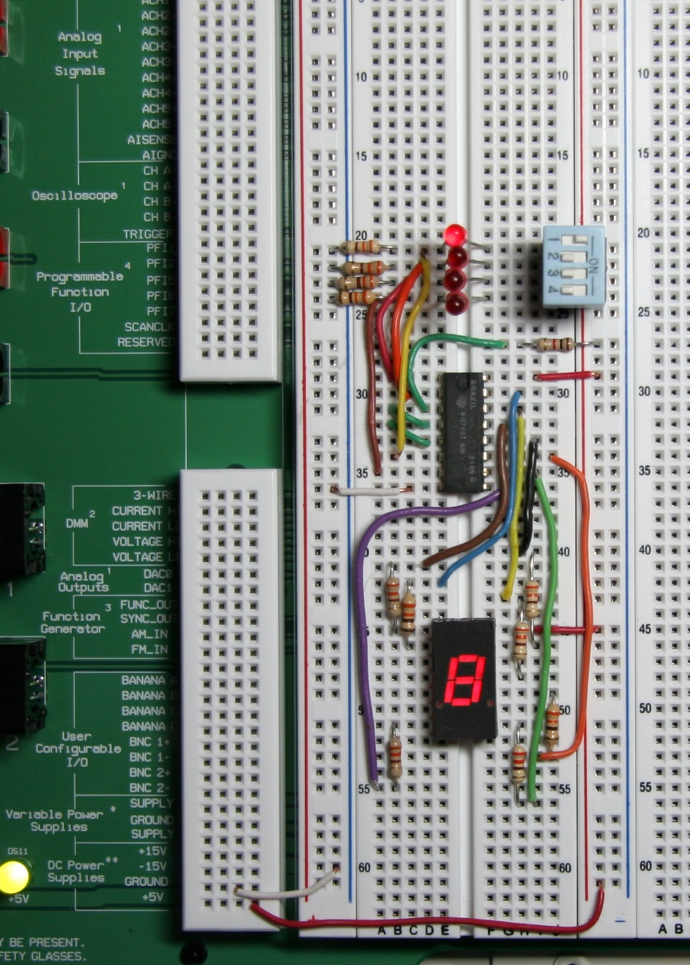
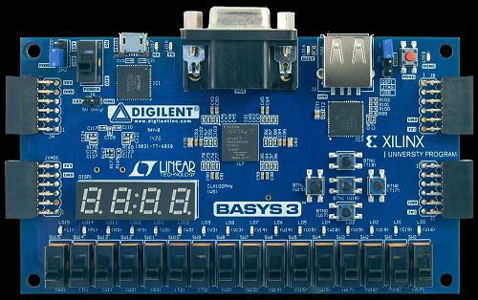
BCD
A lab experiment in which BCD is converted to decimal is shown.

Slide 56
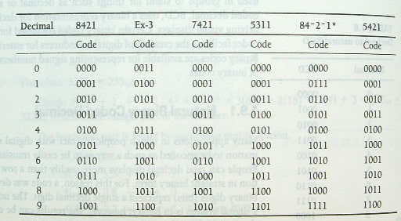
*bcd (Weighted) (加权)二进制编码

Slide 57
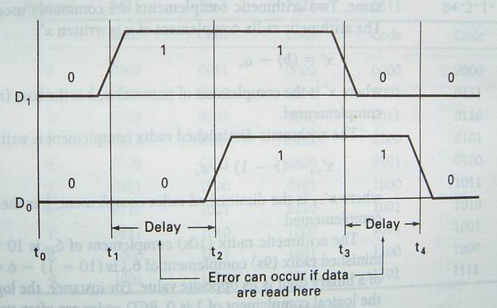
Gray code （格雷码）
Timing diagram illustrating potential error when two bits changes at the same time
01->10
0111->1000

Slide 58
Gray code
2-bit Gray | 3-bit Gray | 4-bit Gray | Binary
00 | 000 | 0000 | 0000
01 | 001 | 0001 | 0001
11 | 011 | 0011 | 0010
10 | 010 | 0010 | 0011
 | 110 | 0110 | 0100
 | 111 | 0111 | 0101
 | 101 | 0101 | 0110
 | 100 | 0100 | 0111
 |  | 1100 | 1000
 |  | 1101 | 1001
 |  | 1111 | 1010
 |  | 1110 | 1011
 |  | 1010 | 1100
 |  | 1011 | 1101
 |  | 1001 | 1110
 |  | 1000 | 1111
Gray code is an unweighted code that has a single bit change between one code word and the next in a sequence.
Gray code is used to avoid problems in systems where an error can occur if more than one bit changes at a time.

Slide 59
Binary → Gray code
Let >> means shift right(右移), ⊕ means exclusive or(异或), then the follow step change N from Binary to Gray code.
N ⊕ (N >> 1 )
Example: change 10110₂ to gray code.
Answer:
1 0 1 1 0
1 0 1 1
1 1 1 0 1
0⊕1=1 1⊕0=1
0⊕0=0 1⊕1=0

Slide 60
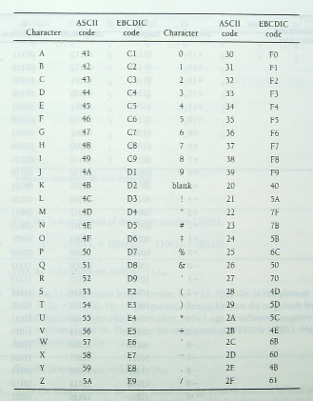
ASCII
ASCII is a code for alphanumeric characters and control characters. In its original form, ASCII encoded 128 characters and symbols using 7-bits. The first 32 characters are control characters, that are based on obsolete teletype requirements, so these characters are generally assigned to other functions in modern usage.
In 1981, IBM introduced extended ASCII, which is an 8-bit code and increased the character set to 256. Other extended sets (such as Unicode) have been introduced to handle characters in languages other than English

Slide 61
Parity Method （奇偶校验法）
The parity method is a method of error detection for simple transmission errors involving one bit (or an odd number of bits).
A parity bit is an “extra” bit attached to a group of bits to force the number of 1’s to be either even (even parity偶校验) or odd (odd parity奇校验).

Slide 62
Parity Method （奇偶校验法）
Example: The ASCII character for “a” is 1100001 and for “A” is 1000001. What is the correct bit to append to make both of these have odd parity?
The ASCII “a” has an odd number of bits that are equal to 1; therefore the parity bit is 0.
The ASCII “A” has an even number of bits that are equal to 1; therefore the parity bit is 1.

Slide 63
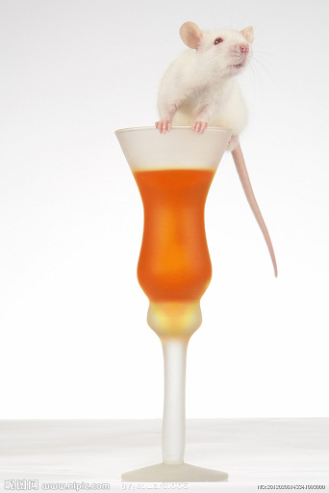
趣味思考
有2018瓶美酒，其中一瓶被加入了泻药。泻药一小时后生效。
问：如果只有一小时时间， 你最少需要多少只小白鼠 来检测出这瓶含泻药的酒？

Slide 64
HOMEWORK
1. Convert the decimal to binary:
1) 12₁₀
2) 34.25₁₀
2. Convert the decimal to BCD
1) 325.6₁₀
2) 1985.67₁₀
3. Find the signed magnitude codes, 1’s complement form and 2’s complement form for the decimal
1) 12₁₀
2) -18₁₀

